Slide 1
50_startup company
Predicting price for 50_startup company

Slide 2

Features in datasets
R&D Spend -- Research and devolop spend in the past few years
Administration -- spend on administration in the past few years
Marketing Spend -- spend on Marketing in the past few years
Profit -- profit of each state in the past few years

Slide 3
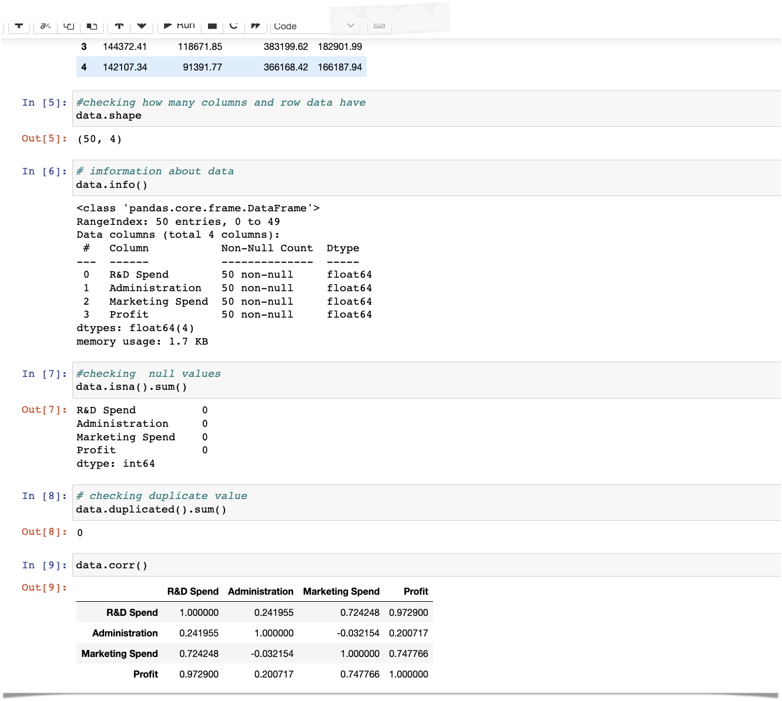
EXPLORATRY DATA ANANLYS
EDA is most important features in data set
In EDA we check shape of the data so there are 50 rows and 4 column in data
There is no duplicate value and nan value
And datatypes is also okay for that columns
I’m also check the correlation value

Slide 4
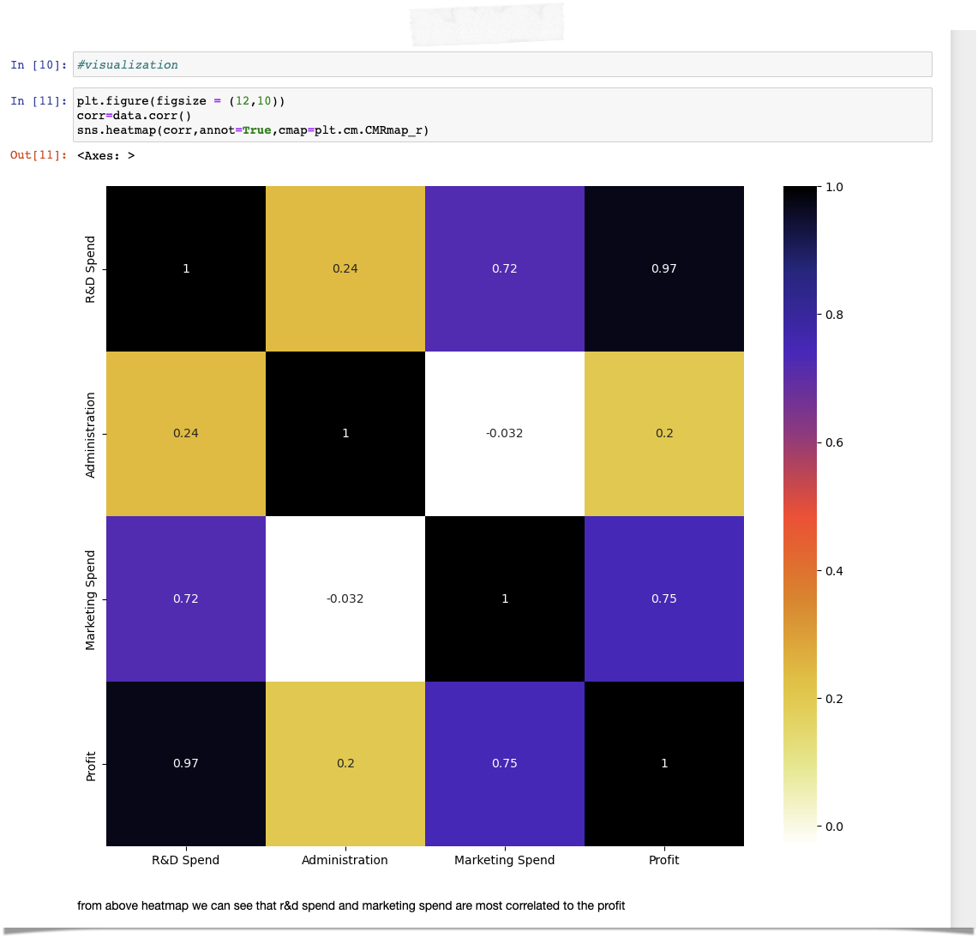
VISUALIZATIONS
I plot correlation heatmap from that I found is R&D and Marketing_spend is highly correlated to profit (target column)

Slide 5
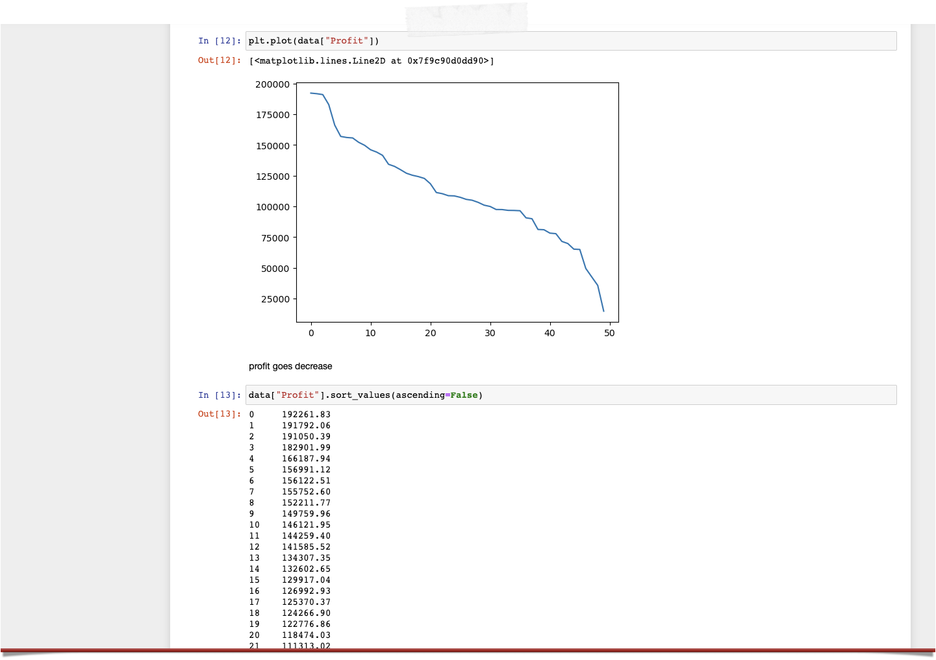
I also make line chart of data from that I found is profit goes decreases as you can see above picture
There is no outlier present in data set

Slide 6
MODEL BUILDING
So this is regression problem.
whenever our target columns is continuous or numeric then we can go for regression problem
I’m building 3 models and check the accuracy and r2 score for each model and make conclusion

Slide 7
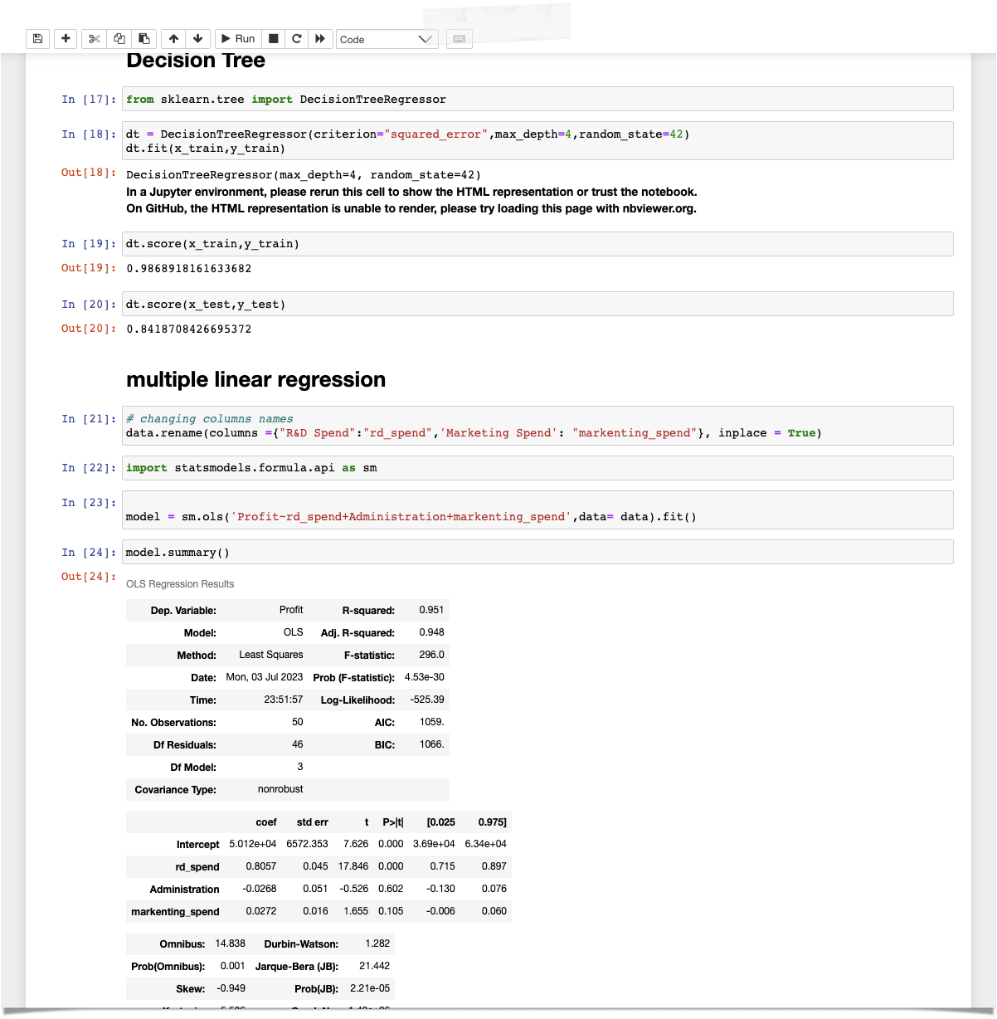
Dt and Multiple linear regression
I’m building decision tree and multiple regression but there are lots of difference between training and testing data sets
For that I’m using feature selection for checking which feature is most important so that we can remove insignificant features

Slide 8
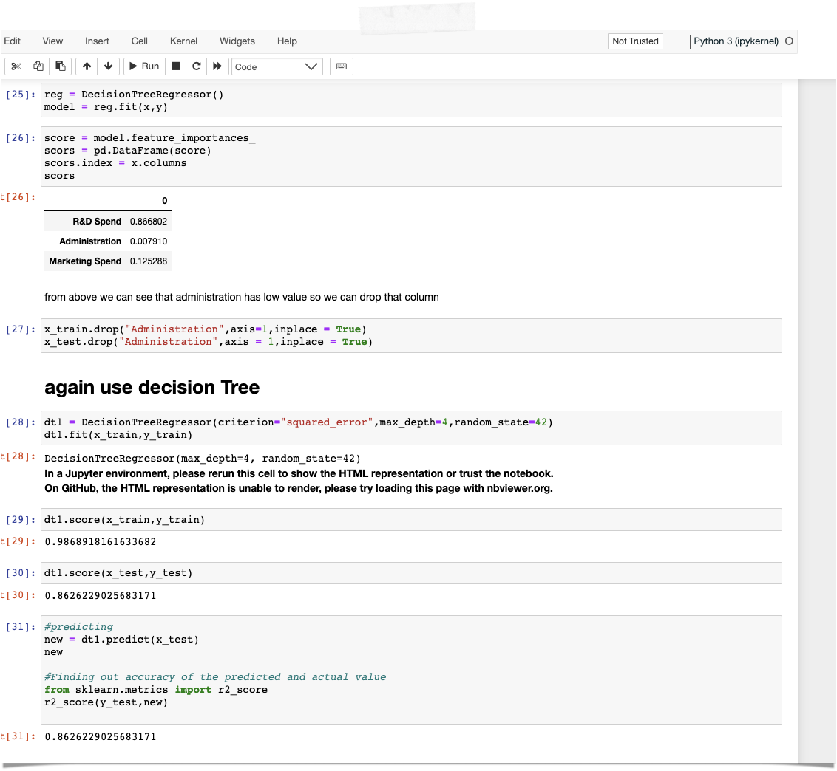
Feature selection
After applying dt then I found that administration is not important feature as you can see above
After removing I again applying decision tree at that time the accuracy is far better then previous

Slide 9
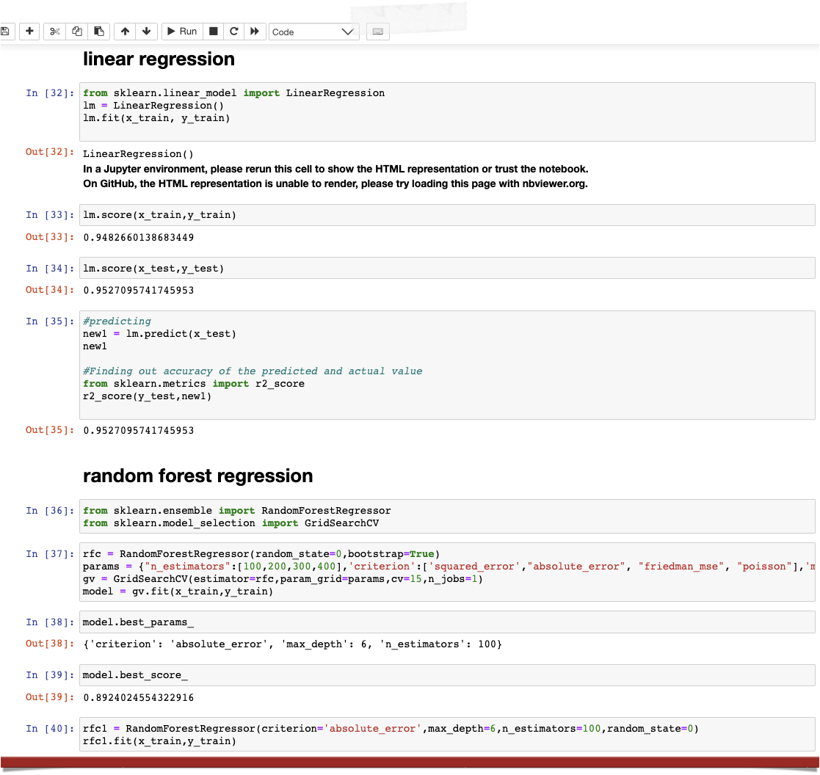
Linear regression
After building and checking all accuracy and score I conclude that linear regression is best model for this data sets and accuracy is 95%

Slide 10
Conclusion
After doing all that thing I conclude that we’ll go ahead with linear regression model
—*—Thank you—*—

